Slide 1

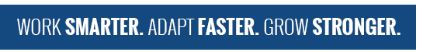

TDD in TypeScript
Test Driven Development
LEANDOG.COM
DEV3LSOLUTIONS.COM
Notes:
8 hours – 1 hour lunch break
7 hours = 420 minutes
10-minute break every hour
- Try to break on exercise to catch up anyone

Slide 2
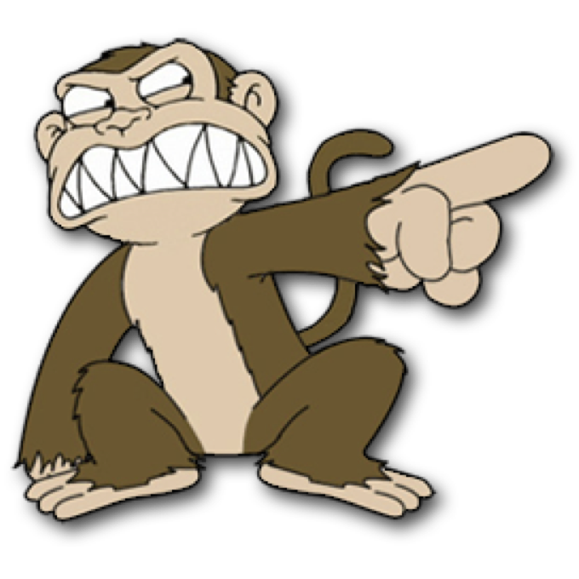

Justin Beall
Justin Beall
15 Years Software Engineering
CSM, A-CSD, CSPO, SA
Favorite language, Python
15 Years Software Engineering
CSM, A-CSD, CSPO, SA
Favorite language, Python
2
Notes:
2m : 2m

Slide 3
INTRODUCTIONS
INTRODUCTIONS
3
Notes:
18m : 20m
Who are we?
Learning environment, feel free to ask questions.
What is everyone’s familiarity with the stack / software development.
Breakout rooms
Regular breaks – shoot for 10 till the hour, leaves room for questions and catch up as necessary
Who are you?
What do you do?
What do you want to learn in class?
Tell me about your automation experience

Slide 4
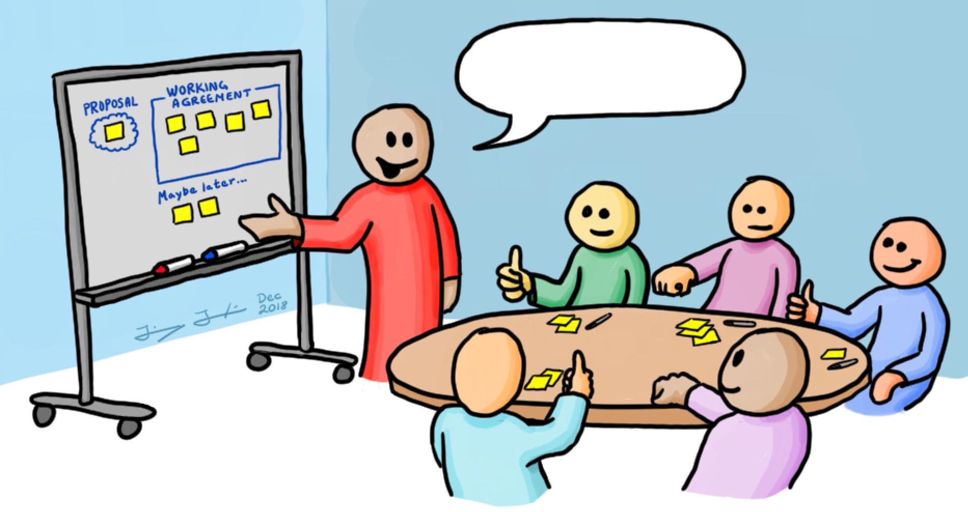

Course Objectives
Working Agreements
Understanding the Benefits of TDD
Learning Good Testing Practices
What code smells to look for
Level up your knowledge!
Start / End Time
- Respect your peers; don’t be late
Be Present
- Participate
Own your learning
- Speak up if you don’t understand something
You aren’t done until the (virtual) person next to you is done
Code (1) Make it work; (2) Make it better
Notes:
5m : 25m

Slide 5

Course Objectives
Recognize available TDD tools
Summarize the value of TDD
Use TDD to solve Katas
Integrate TDD Into Daily Work
Notes:
5m : 30m

Slide 6
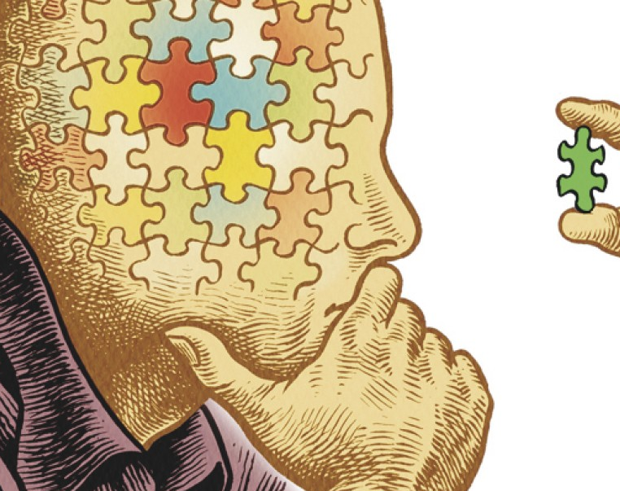
Why Are We Here?
Notes:
5m : 35m
How is testing performed currently?
Why Test First, not Test After?
-- war stories
Has anyone been on a project using TDD?
Has anyone worked on a legacy project?
Touch one thing over here, and something breaks over there

Slide 7
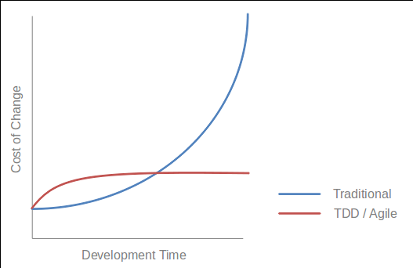
What is Test Driven Development?
A Programming Discipline
High-feedback incremental coding technique
Write tests as specs, prior to code
Core of the cycle:
Write a test
Write the code to make the test pass
Notes:
10m : 35m
--- What
Test-driven development (TDD) is a software development process that relies on the repetition of a very short development cycle:
Requirements are turned into very specific test cases, then the software is improved to pass the new tests, only. This is at the Unit Level (Classes and Methods in Code).
This is opposed to software development that allows software to be added that is not proven to meet requirements.
--- Discipline
TDD is a discipline, disciplines are arbitrary or at least they have arbitrary components to them. Disciplines have arbitrary behaviors that are driven by some substantial motives.
For example, how do doctors wash their hands before surgery? Do they just go in there and wash hands like normal people do? no, there is discipline something like this. There is special brush, soap and they turn on the water and it is ten strokes across the side of fingers. You understand why they do that, there is motive behind that, but is ten the right number? could it be twelve or eight, it is arbitrary. It is just a guess, ten probably enough.
The discipline is motivated by something real. The discipline of TDD works like this, There are three rules.
--- Double Entry Bookkeeping
We produce documents filled with code - arcane symbols in strange shapes and structure, no one else can read them only programmers.
What other field, employment has problem like that? Where they construct the document that are arcane and full of symbols and every symbols have to be correct. Accountants. How do accountants make sure that their documents are correct? They have a discipline that was invented 500 years ago, called Double-entry bookkeeping. They enter everything twice. TDD is Double-entry bookkeeper, is exactly the same discipline done for precisely same reason, we say everything twice, once on test side, once on production code side, they follow execution, complimentary execution pathways they wind up with zero, zero test failed. Same discipline, Same reason, Same outcome.

Slide 8
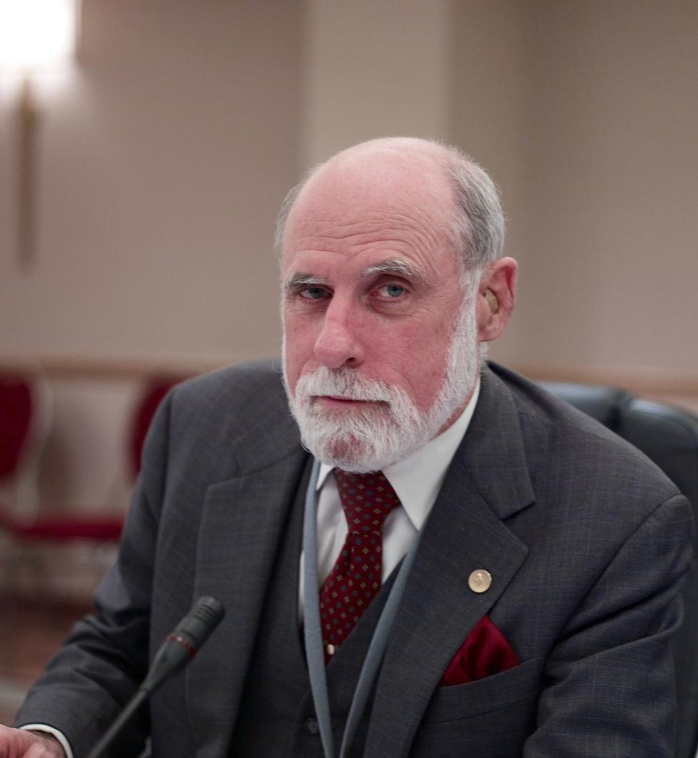
Test First is NOT new
“A software system can best be designed if the testing is interlaced with the designing instead of being used after the design.” - Professor Alan J. Perlis
NATO SOFTWARE ENGINEERING CONFERENCE 1968
Notes:
5m : 40m
An American computer scientist and professor at Purdue University, Carnegie Mellon University and Yale University. He is best known for his pioneering work in programming languages and was the first recipient of the Turing Award.
If thought leaders believed this back in the late 60’s, why is it not common place today?

Slide 9
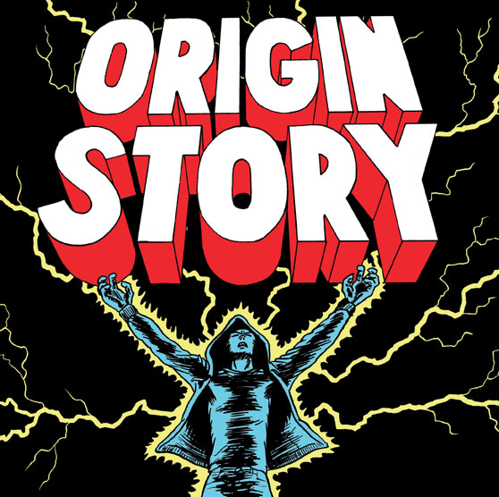
Kent Beck’s "rediscovering" TDD
“The original description of TDD was in an ancient book about programming. It said you take the input tape, manually type in the output tape you expect, then program until the actual output tape matches the expected output. After I'd written the first xUnit framework in Smalltalk I remembered reading this and tried it out. That was the origin of TDD for me. When describing TDD to older programmers, I often hear, "Of course. How else could you program?" Therefore, I refer to my role as "rediscovering" TDD.”
Notes:
5m : 45m
American software engineer Kent Beck, who is credited with having developed or "rediscovered" the technique, stated in 2003 that TDD encourages simple designs and inspires confidence.
The SUnit (later to be known as xUnit) was designed by Kent Beck in 1998
---
Automated unit testing nothing new
But writing the tests incrementally and first is
Automation originally devised by Ward Cunningham
Honed by Kent Beck in Smalltalk
Incorporated as a practice of Extreme Programming (XP)

Slide 10
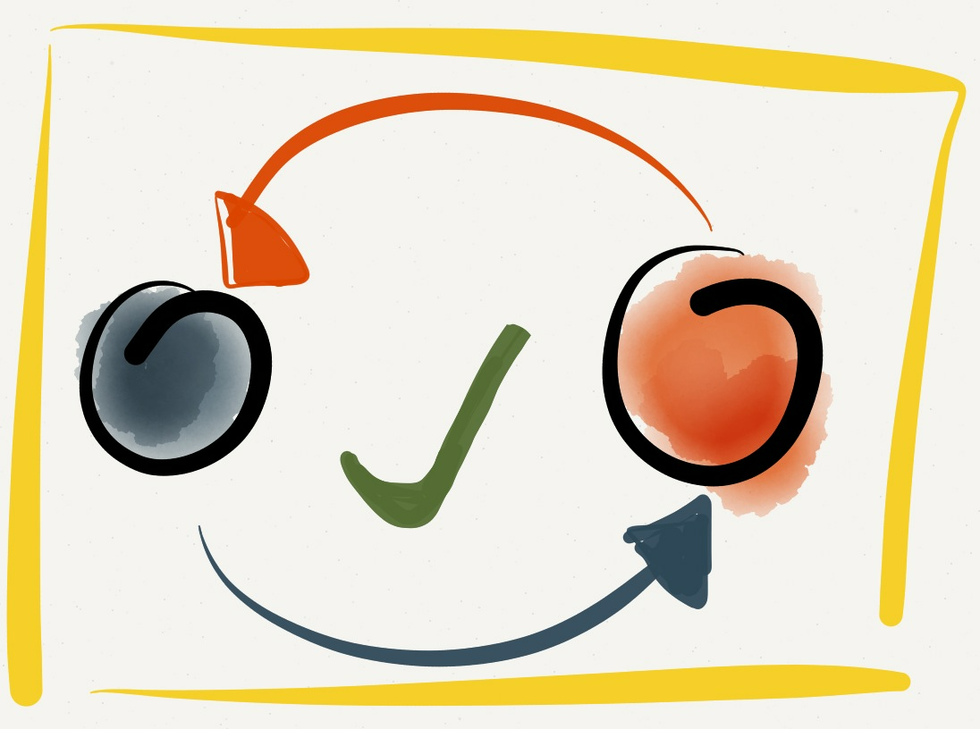
The Three Laws of TDD
1. You are not allowed to write any production code unless it is to make a failing unit test pass.
2. You are not allowed to write any more of a unit test than is sufficient to fail; and compilation failures are failures.
3. You are not allowed to write any more production code than is sufficient to pass the one failing unit test.
Notes:
10m : 55m
Test Driven Development as described by Uncle Bob Martin
Break down each one of the laws and discuss what it means. “Following these laws perfectly doesn’t always make sense.
Sometimes you’ll write a larger test.
Sometimes you’ll write extra production code.
Sometimes you’ll write tests after you’ve written the code to make them pass.
Sometimes it’ll take more than two minutes to go around the loop.
The goal isn’t perfect adherence to the laws—it’s to decrease the interval between writing tests and production code to a matter of minutes. “ - Uncle Bob

Slide 11
The Three Laws of TDD
1. Only write production code to make a failing unit test pass
2. Only write enough of a unit test to make the test fail
3. Only write enough implementation to make failing test pass
Notes:
0m : 55m
Rules simplified As a discipline, what do we get by following these laws?

Slide 12

Doing TDD
A skill which you must learn and practice - Expect it to be initially awkward
Expect some level of addiction - Fast feedback & Green Tests = more dopamine!
Notes:
5m : 60m
Like any new skill – initially writing tests can be awkward Typically used to diving right into problem solving through implementation Writing a test first forces you to think about the expected outcome of a VERY small step
As you get into a rhythm, every time you make a new test pass – it starts building up excitement

Slide 13

BREAK
Notes:
10m : 70m

Slide 14
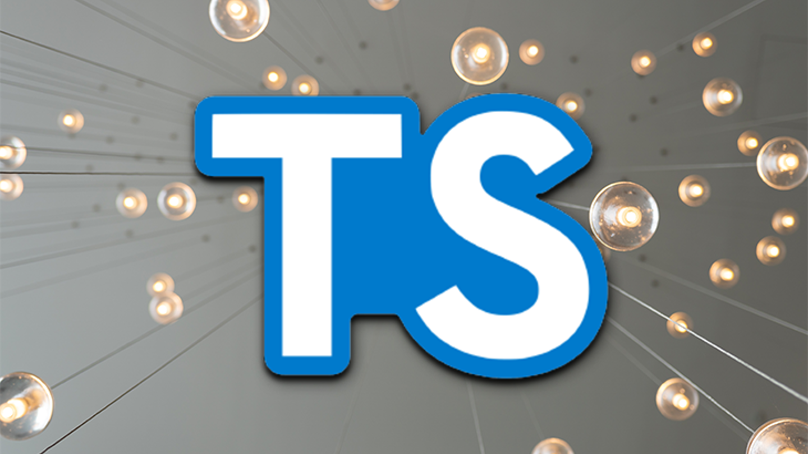
TypeScript Overview
00_typescript
Notes:
15m : 85m
Make sure everyone has computer configured and runnable.
If we run into problems, pair up and resolve the problems at lunch time.
Review TypeScript.
Walk before you run.
How can we get started?
Make sure everyone can run TypeScript

Slide 15
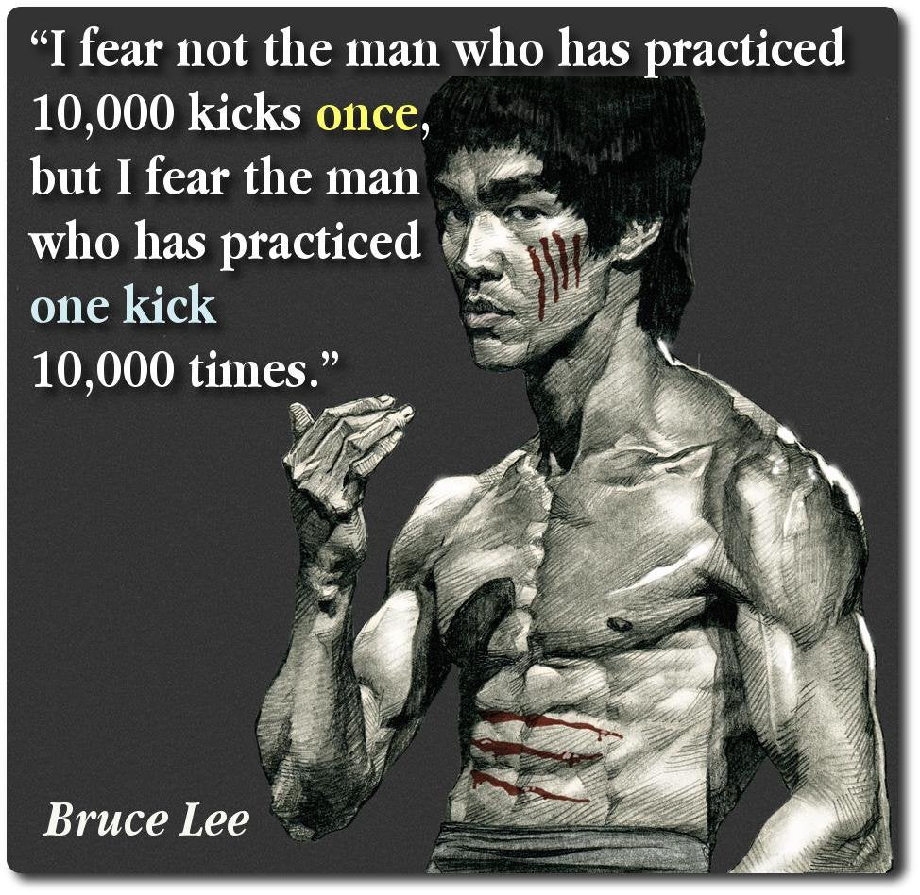
Kata
Notes:
10m : 85m
Kata is a Japanese word meaning "form".
It refers to a detailed choreographed pattern of martial arts movements made to be practised alone.
It can also be reviewed within groups and in unison when training.
It is practised in Japanese martial arts as a way to memorize and perfect the movements being executed.
Does anyone here ever “practice” programming?
- What other professions involve daily practice?
Is anyone aware of any know any programming practice sites?
- “koans” : https://github.com/paytonrules/typescript.koans - “Coding Dojo” : https://codingdojo.org/
- “Hacker Rank” : https://www.hackerrank.com/ - “Exercism.io” : https://exercism.org/

Slide 16
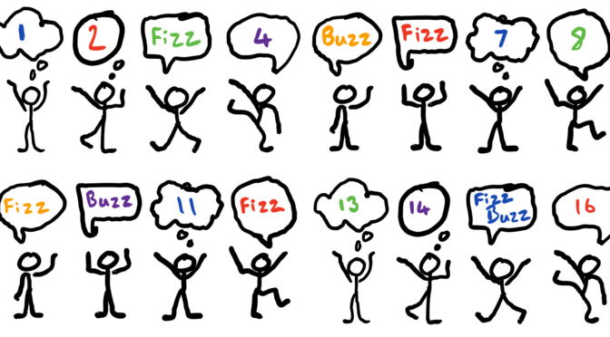
Kata: Fizz Buzz
01_fizz_buzz
Notes:
30m : 115m
Has anyone here ever done FizzBuzz?
Has anyone here ever done FizzBuzz using TDD??
Discuss problem – give hint about the modulo operator “%”

Slide 17

Review
Notes:
10m : 125m
What went well?
What didn’t go well?
Look at some solutions
What if we wanted to use classes?
What if we wanted to use only a function?
What if we didn’t want to use any for loops?

Slide 18

BREAK
Notes:
10m : 135m

Slide 19
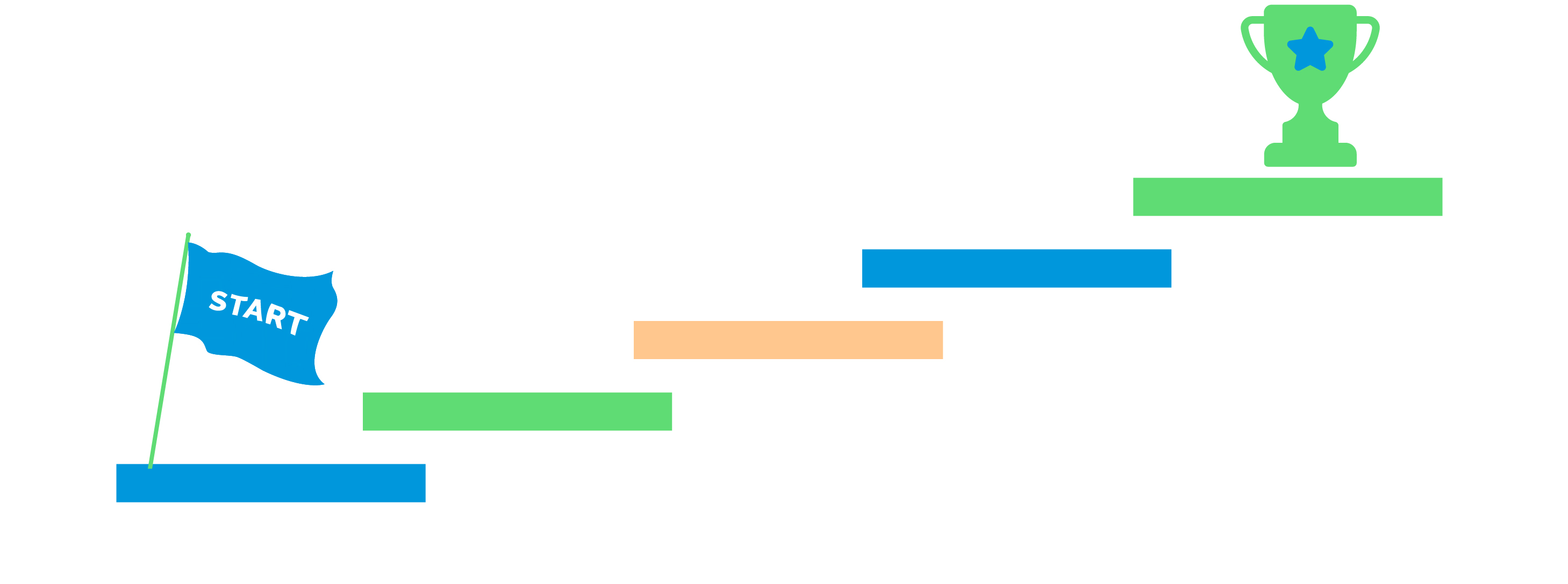
TDD Steps
- Write test (red) - Write implementation (green)
- Write test (red) - Write implementation (green)
…
Notes:
5m : 140m
If it is this simple, then why is it so hard to do?
Why is test first different than test after?
- Which one drives the design?
Where do we begin?

Slide 20
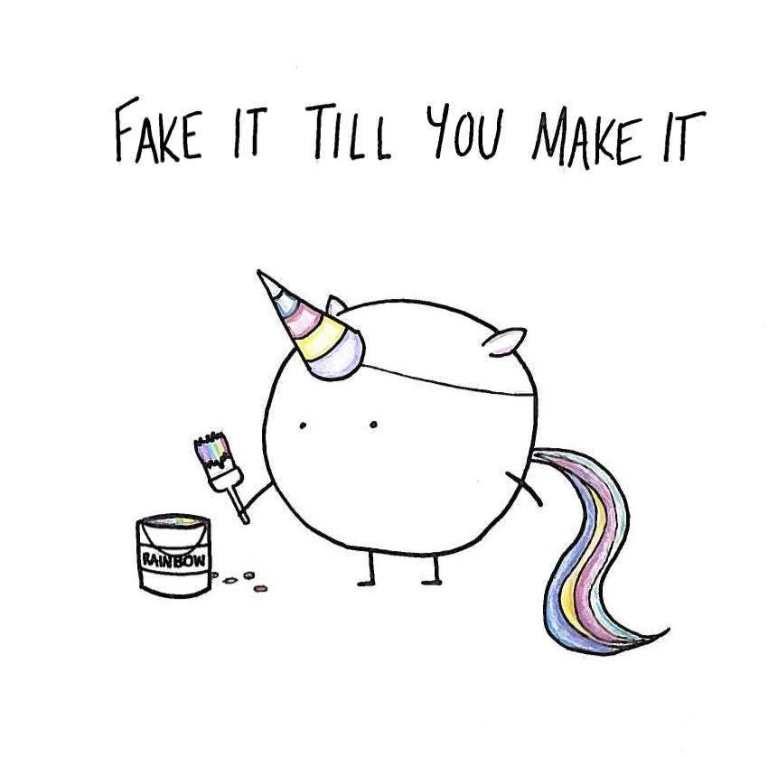
Notes:
5m : 145m
Fake it 'til you make it says to write the simplest possible thing to pass your current tests. Frequently, when you've written a single test case for a new feature, that simplest possible thing is to return a constant. When something that simple satisfies your tests, it's because you don't (yet) have enough tests. So write another test. Now the feature you're developing needs some logic to it. Maybe this time the simplest possible thing is to write very basic if-else logic to handle your two test cases. You know you're faking it, so you know you're not done. When it becomes simpler to write the actual code to solve your problem than to extend your fake to cover yet another test case - that's what you do. And you've got enough test cases to make sure you're writing it correctly.
If you are not used to this, it will drive you insane at first… you know the solution, will require <x> - so why not just implement that?

Slide 21
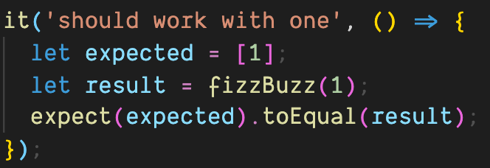
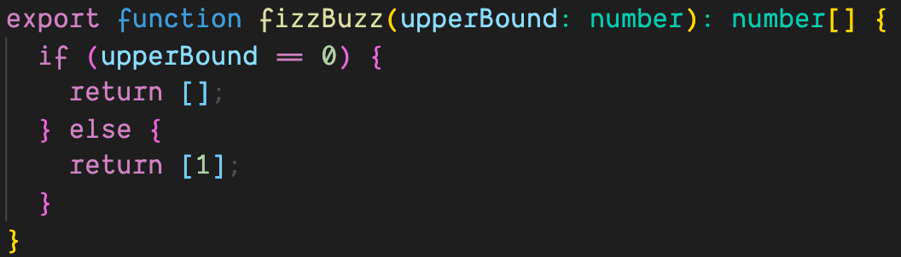
Notes:
5m : 150m
When we look at this, we obviously know this is not the desired solution – but as far as our tests are concerned, this is all the matters
What is the value in this? “Earning Complexity”
Regardless of the implementation, “it should work with one” will ALWAYS pass – having this safety net allows us to expand into much more complicated business object
Where else do we return stubbed results? Front end developing against a non-existent API – we know the shape, we know the expected results, but until complete we just return a static result

Slide 22
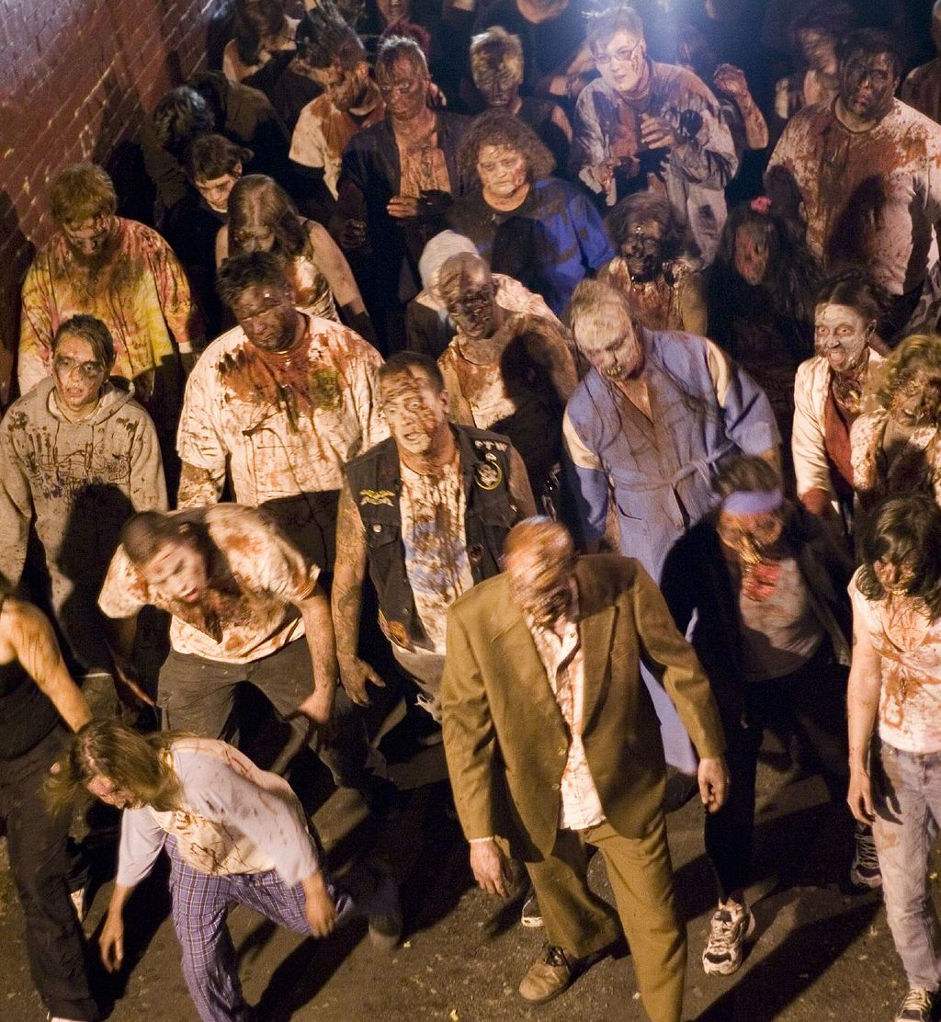
TDD Guided by ZOMBIES
Z – Zero O – One M – Many (or More complex) B – Boundary Behaviors I – Interface definition E – Exercise Exceptional behavior S – Simple Scenarios, Simple Solutions
https://blog.wingman-sw.com/tdd-guided-by-zombies
Notes:
15m : 165m
Have you had a hard time figuring out where to start with Test-Driven Development.
People new to TDD often struggle with what test to write. It’s hard to know where to start or what test to write next. It’s hard to know when you are done, and it’s scary to think you will leave some incomplete code behind
When test-driving, guided by ZOMBIES, the first test Scenarios are for Simple post-conditions of a just created object. These are the Zero cases. While defining the Zero cases, take care to design the Interface and capture the Boundary Behaviors in your test Scenarios. Keep it Simple, both Solutions and Scenarios. You’ll find that hard. Once progress is made on the Zero cases, move to the next special Boundary case, testing the Behavior desired when transitioning from Zero to One. To do so there are likely other Interfaces to define and use in new test Scenarios. Once the Boundary Behaviors between Zero and One (and possibly back to Zero from One) have been captured in tests, move on to start to generalize your design now dealing with More complex Scenarios and Many items being managed. Often there are new Boundary conditions to be concerned with. Finally review your work and make sure you consider and Exercise the Exceptional things that might happen
Go through each step, in regards to Fizz Buzz
http://blog.wingman-sw.com/tdd-guided-by-zombies

Slide 23
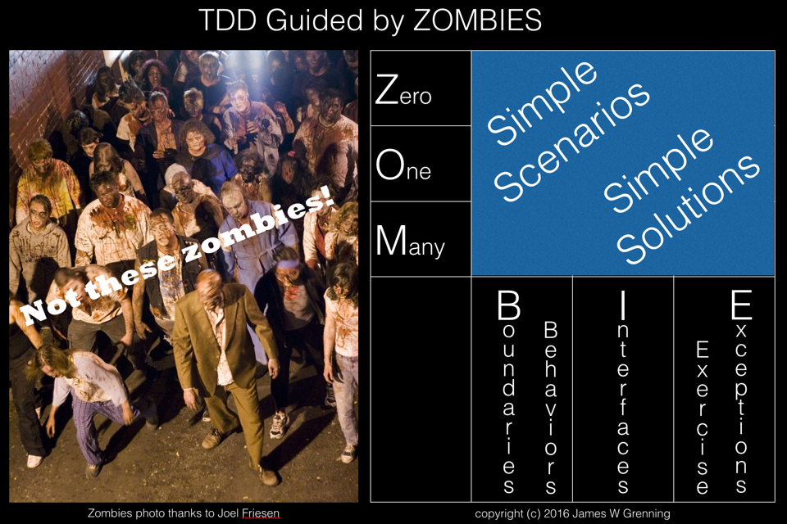
01_fizz_buzz_zombies
Notes:
30m : 195m
Implement Fizz Buzz using ZOMBIES - class follows along, make space for questions

Slide 24

REVIEW
Notes:
15m : 210m
Was that different than how anyone else implemented their Fizz Buzz solution?

Slide 25

BREAK
Notes:
10m : 220m (Lunch)

Slide 26
TDD and Testing Outcomes
Creates testable code by definition
Obvious but significant!
Writing tests after code built usually much harder
Contributes to minimizing defects

Slide 27
More Importantly...
TDD promotes better design
Teaches you how to design isolated pieces
Creates comprehensive developer-level documentation
Development pacing
Constant positive feedback
Pavlovian effect
Tests are specifications!
Should never build a system without specs

Slide 28
TDD Costs (Perceived)
Takes twice as long
Reality: easily saves more time
Maintain test and code
Reality: beats maintaining written detailed docs
Not all that valuable - tough work is in the “wiring”
Reality: not if classes are designed correctly in the first place

Slide 29
TDD Costs (Real)
Initial learning curve
Continual Learning: How do I test X?
Can promote overconfidence
Maintaining tests can be considerable work

Slide 30
TDD Rewards
Higher confidence levels
Continual feedback; Pavlovian response
Eases introduction of new functionality
Allows for refactoring with impunity
Continual progress: add value...
Add value every programming session, every few minutes
Avoid going too astray

Slide 31
The Implied Rules of TDD
Test everything that could possibly break.
Do not write any production code until you have written the code that will test it.
Code is not checked in until 100% of unit tests run.

Slide 32
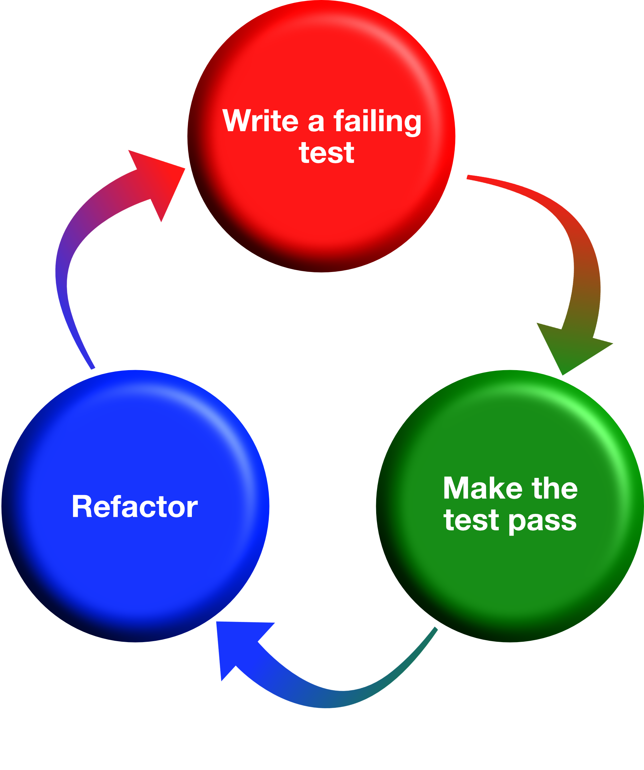
Red, Green, Refactor

Slide 33
Basic Tool of TDD: xUnit
Simple testing framework
Originally built by Kent Beck and Eric Gamma
Pervasive implementation
Java, .NET, Smalltalk, Ruby, C/C++, Perl, Python, etc
Test Runner already in many IDEs
Rubymine, Rider, Visual Studio, Eclipse, IntelliJ, PyCharm, etc.
Notes:
xUnit is the collective name for several unit testing frameworks that derive their structure and functionality from Smalltalk's SUnit. SUnit, designed by Kent Beck in 1998
We are using MiniTest for this course

Slide 34
Unit Test Tooling for This Class
Test::Unit
Original xUnit based testing framework
MiniTest
Successor to Test::Unit
RSpec
A BDD (behavior driven development) framework
Notes:
xUnit is the collective name for several unit testing frameworks that derive their structure and functionality from Smalltalk's SUnit. SUnit, designed by Kent Beck in 1998
We are using MiniTest for this course

Slide 35
Refactor
Ensure all previous tests are still passing
Clean up the code without adding new functionality
Address readability, naming
Remove duplication
Commit

Slide 36
What does it all mean?
require 'minitest/autorun' <- Run all tests in file class FizzBuzzTest < Minitest::Test <- Base class for tests
def test_returns_fizz_when_passed_3 assert_equal "fizz", fizzbuzz(3) <- Check expected vs actual end
end
Notes:
#require 'minitest/pride' - Colorize test output
#require 'minitest/hell' - Multi-threaded test execution

Slide 37
More Assertions (aka Requisite Eye Chart)
Assert.AreEqual(expected, actual)
Assert.AreSame(expected, actual)
Assert.Null(actual)
Assert.IsEmpty(actual)
Assert.Contains(item, collection)
Assert.IsInstanceOf(expected, actual)
Assert.Throws(exception type, test delegate)
Assert.AreNotEqual
Assert.AreNotSame
Assert.NotNull
Assert.IsNotEmpty
Assert.IsNotInstanceOf
Assert.DoesNotThrow

Slide 38
Rinse & Repeat
fizzbuzz_test.rb:
class FizzBuzzTest < Minitest::Test
...
def test_returns_buzz_when_passed_5 assert_equal "buzz", fizzbuzz(5) end ...
end
Notes:
Add the next test

Slide 39
Rinse & Repeat
FizzBuzzTest.cs:
[Test] public void returns_buzz_when_passed_5()
{ Assert.AreEqual("buzz", FizzBuzz.Eval(5)); }
Notes:
Add the next test

Slide 40
Red
$ ruby fizzbuzz_test.rb
.F
Failure: FizzBuzzTest#test_returns_fizz_when_passed_3
[fizzbuzz_test.rb:6]: Expected: "fizz" Actual: nil bin/rails test fizzbuzz_test.rb:5 2 runs, 2 assertions, 1 failures, 0 errors, 0 skips
Notes:
Talk about the test output, Green dot passed test, Red F assert failure, Red E compile error...

Slide 41
Red
1) Failed : FizzBuzzTest.returns_buzz_when_passed_5 String lengths are both 4. Strings differ at index 0. Expected: "buzz" But was: "fizz" -----------^ Test Run Summary Overall result: Failed Test Count: 2, Passed: 1, Failed: 1, Warnings: 0, Inconclusive: 0, Skipped: 0
Notes:
Talk about the test output, Green dot passed test, Red F assert failure, Red E compile error...

Slide 42
fizzbuzz.rb: def fizzbuzz(value)
if value == 3 return "fizz" end if value == 5 return "buzz" end end

Slide 43
FizzBuzz.cs: public static string Eval(int i) { if (i == 3) return "fizz";
if (i == 5) return "buzz";
return ""; }

Slide 44
Green
ruby fizzbuzz_test.rb # Running: .. Finished in 0.000888s, 2252.2523 runs/s, 2252.2523 assertions/s. 2 runs, 2 assertions, 0 failures, 0 errors, 0 skips

Slide 45
Green
Test Run Summary Overall result: Passed Test Count: 2, Passed: 2, Failed: 0, Warnings: 0, Inconclusive: 0, Skipped: 0

Slide 46
Refactor
fizzbuzz.rb: def fizzbuzz(value) case when (value % 3 == 0) return "fizz" when (value % 5 == 0) return "buzz" end end
Notes:
Contrived refactor just to demonstrate that we are safe to muck with the code as we are covered by the tests

Slide 47
Refactor
FizzBuzz.cs: public static string Eval(int i) { if (i % 3 == 0) return "fizz"; if (i % 5 == 0) return "buzz"; return ""; }
Notes:
Contrived refactor just to demonstrate that we are safe to muck with the code as we are covered by the tests

Slide 48
Green
ruby fizzbuzz_test.rb # Running:
.. Finished in 0.000820s, 2439.0244 runs/s, 2439.0244 assertions/s. 2 runs, 2 assertions, 0 failures, 0 errors, 0 skips
Notes:
We are still green after refactoring

Slide 49
Green
Test Run Summary Overall result: Passed Test Count: 2, Passed: 2, Failed: 0, Warnings: 0, Inconclusive: 0, Skipped: 0
Notes:
We are still green after refactoring

Slide 50

LET’S GO BOWLING
Notes:
This is the part where we jump into a browser and go to CyberDojo.org. Do a little live coding of Bowling Game KATA
https://cyber-dojo.org/kata/edit/0z80Rs

Slide 51
LUNCH

Slide 52
SOFTWARE DESIGN & TDD

Slide 53
TDD So Far...
How does it help?
Based upon what you’ve learned so far
Testing all of the time
Design all of the time?
Build classes in isolation
Consistently adapt design to changing requirements
That’s only part of it

Slide 54
Software Development Activities
Software development requires:
Analysis, design, coding, testing, review, documentation, planning, deployment, etc.
Absence of any one of these is hacking
Waterfall attempts to serialize these
Agile Solution: Learn to do all activities all the time

Slide 55
Upfront Design
We still do it
Mostly at planning meetings
But with less details
Design insights often only occur when coding
UML Sketches
“Inception” level diagrams
Help Solve the problem but don’t completely specify the code

Slide 56
Recognizing You Have a Problem
Long Method smell (Fowler)
Not very expressive, contains duplication (Simple Design)
Contains guiding comments (Simple Style)
Breaks the Single Responsibility Principle (Martin)
Notes:
Inappropriate Intimacy – One class uses the internal fields and methods of another class, knows too much about inner workings!

Slide 57
Refactoring
Ensure code has optimal design always
Another way to do “agile” design
Entropy is unavoidable
Learn how to deal with it all along product lifecycle
Code transformations, not performance optimizations
Take small, safe steps
The third, critical leg of the TDD cycle
Notes:
Code changes during refactoring should NOT change external behavior of code

Slide 58
Refactoring Drivers
Code Smells
Classic design principles – SOLID, DRY, etc
Design Patterns (Gang of Four)

Slide 59
EXAMPLE REFACTORINGS

Slide 60
Refactorings: Extract Method
Problem:
You have a code fragment that can be grouped together
Benefits:
More readable code!
Less code duplication
Isolates independent parts of code, so that errors are less likely

Slide 61
Refactorings: Move Method
Problem:
A method is used more in another class than in its own class
Why Refactor?
You want to move a method to a class that contains most of the data used by the method (classes more internally coherent)
You want to move a method in order to reduce or eliminate the dependency of the class calling the method on the class in which it’s located

Slide 62
Refactorings: Replace Temp with Query
Problem:
You place the result of an expression in a local variable for later use in your code
Why Refactor?
This refactoring can lay the groundwork for applying Extract Method for a portion of a very long method

Slide 63
Code Smells
“Code smells are usually not bugs; they are not technically incorrect and do not prevent the program from functioning. Instead, they indicate weaknesses in design that may slow down development or increase the risk of bugs or failures in the future. Bad code smells can be an indicator of factors that contribute to technical debt.”
"When and Why Your Code Starts to Smell Bad"
2015 37th IEEE International Conference on Software Engineering (ICSE).

Slide 64
Application-level smells
Duplicated code
Contrived complexity
Shotgun surgery
Notes:
Duplicate code: Identical or very similar code exists in more than one location.
Contrived complexity: Forced usage of over complicated design patterns where simpler design would suffice.
Shotgun surgery: A single change needs to be applied to multiple classes at the same time.

Slide 65
Class-level smells
Large class
Feature envy
Inappropriate intimacy
Excessive use of literals
Cyclomatic complexity
Notes:
Large class: a class that has grown too large. See God object.
Feature envy: a class that uses methods of another class excessively.
Inappropriate intimacy: a class that has dependencies on implementation details of another class.
Excessive use of literals: these should be coded as named constants, to improve readability and to avoid programming errors.
Additionally, literals can and should be externalized into resource files/scripts, or other data stores such as databases where possible, to facilitate localization of software if it is intended to be deployed in different regions.
Cyclomatic complexity: too many branches or loops; this may indicate a function needs to be broken up into smaller functions, or that it has potential for simplification.

Slide 66
Method-level smells
Too many parameters
Long method
Excessively long identifiers
Excessively short identifiers
Excessive return of data
Excessively long line of code
Notes:
Too many parameters: a long list of parameters is hard to read, and makes calling and testing the function complicated.
It may indicate that the purpose of the function is ill-conceived and that the code should be refactored so responsibility is assigned in a more clean-cut way.
Long method: a method, function, or procedure that has grown too large.
Excessively long identifiers: in particular, the use of naming conventions to provide disambiguation that should be implicit in the software architecture.
Excessively short identifiers: the name of a variable should reflect its function unless the function is obvious.
Excessive return of data: a function or method that returns more than what each of its callers needs.
Excessively long line of code: A line of code which is so long, making the code difficult to read, understand, debug, refactor, or even identify possibilities of software reuse.

Slide 67
MITIGATING CODE SMELLS

Slide 68
Code Smells: Feature Envy
Symptom:
A method accesses the data of another object more than its own
Treatment:
If a method clearly should be moved to another place, use Move Method
If only part of a method accesses the data of another object, use Extract Method to move the part in question
Notes:
Explicitly named smell: method is envious of other class
Tighter coupling
Violates “tell don’t ask”
Payoff
Less code duplication (if the data handling code is put in a central place).
Better code organization (methods for handling data are next to the actual data).

Slide 69
Code Smells: Long Parameter List
Symptom:
More than three or four parameters for a method
Treatment:
Instead of passing a group of data received from another object as parameters, pass the object itself to the method
If there are several unrelated data elements, sometimes you can merge them into a single parameter object
Notes:
Payoff
More readable, shorter code.
Refactoring may reveal previously unnoticed duplicate code.

Slide 70
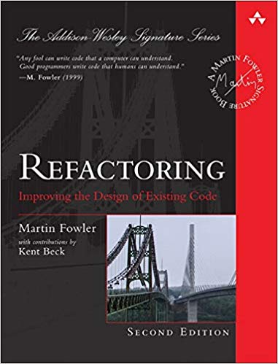
Reference Book on Refactoring

Slide 71
Refactor smelly code - Using TDD concepts
asdf

Slide 72
Refactoring Tips
Don’t refactor and change behavior simultaneously
Always run tests
If tests aren’t available, take only safe proven steps
Never skip the third leg of the TDD cycle
Avoid having to ask permission
Refactoring is part of your development process

Slide 73
LET’S REVIEW

Slide 74
DAY 1 - WRAP UP

Slide 75
DAY 2

Slide 76
DAY 1 - RECAP

Slide 77
SUT – System Under Test
The thing we’re currently writing Unit Tests for
Can have 1 or more dependencies (Fowler calls them “collaborators”)

Slide 78
Dependencies, Decoupled...
You want to isolate the SUT as much as possible!
Building an entire app object graph just for Unit Testing is not practical
Databases should never be a part of a Unit Test!
Loose Coupling Saves Lives!

Slide 79
Mocks and Fakes and Stubs, Oh My!
All the same thing: objects that simulate the behavior of real objects
This is how we decouple the “collaborators” from the SUT
Allows us to go beyond simply verifying just the state of the SUT
Opens the door to let us verify the behavior of the SUT

Slide 80
Mocks vs Stubs vs Fakes – Wha'choo talkin' 'bout, Willis?
Welcome to a controversial topic!
Stubs can be thought of having minimalistic behavior – just enough to allow the object under test to execute the test
A Mock is like a “smart” Stub in that the test will also verify that the object under test calls the mock as expected
A Fake has business behavior. You can drive a fake to behave in different ways by giving it different data

Slide 81
Mocks – How to use them
Most languages have a mocking framework available to use
Mocks and Stubs are easily created with a mocking framework
A Fake is usually easier to code by hand, but can still be done with a mocking framework

Slide 82
Mock Example Walkthrough – SUT
require subscription_service.rb
class User
def apply_subscription
SubscriptionService.new(self).apply
end
end

Slide 83
class UserTest < MiniTest::Test
test '#apply_subscription' do
mock = Minitest::Mock.new
mock.expect :apply, true
SubscriptionService.stub :new, mock do
user = users(:one)
assert user.apply_subscription
end
assert_mock mock # New in Minitest 5.9.0
assert mock.verify # Old way of verifying mocks
end
end

Slide 84
Mock Example – Third test walkthrough
asdf

Slide 85
Guided kata - execute first kata with scenarios
adf

Slide 86
Guided kata - execute first kata with scenarios
asdf

Slide 87
Designing for testability - examples
asdf

Slide 88
SIMPLE EVOLUTIONARY DESIGN

Slide 89
Design
Design principles and patterns
- vs -
Simple design
BDUF (Big Design Up Front)
- vs -
Emergent design

Slide 90
Simple Design
Runs all tests
No duplication
Expresses intent
Minimal number of classes & methods

Slide 91
Simple Design
Implies use of TDD
TDD promotes “tell don’t ask”
TDD pushes you to think about “how do I test this class in isolation?”
Minimizes coupling: the core of good OO design
Implies the system works as designed
Automated tests prove it

Slide 92
Simple Design: No Duplication
Duplication is your primary enemy
Increased cost: multiple places to make changes
Increased cost: overall comprehension of system
Increased risk: forgot to change on of these places
Drives toward many design patterns / principles
Single Responsibility Principle, Template Method, Open-Closed Principle

Slide 93
Simple Design: Expresses Intent
Directly relates to maintenance costs
Core idea behind design patterns
Communicating ideas using common terms / solutions
Promotes single responsibility principle

Slide 94
Simple Design: Minimal Number of Classes & Methods
Prevents over design
You don’t build things into the system that aren’t needed
Stopgap measure
Sometimes methods and classes don’t pull their own weight

Slide 95
It is Agile Software Design!
“Just enough” up-front design
Constant test-first unit testing
Constant attention to design impacts
Ruthless refactoring
It’s only code!
Malleable
Keep as clean as possible to ease addition of new features

Slide 96
Documentation Artifacts
Cost money!
Introduce into plan and estimate
Make executable where possible
Unit tests can supplant code specs, heredocs, design docs
Acceptance tests can supplant use cases, requirements docs

Slide 97
OTHER CONSIDERATIONS

Slide 98
How Big is a Test Method?
Multiple asserts might be a code smell
Could be too much in one test
Test functionality, not methods
Could suggest deficient design
Look to decouple behavior of classes under test
Underlying code may be linked
Look to combine into common assert method
One assert / test is a goal, not a rule

Slide 99
How Big is a Test Class?
Generally one test class per production class
But you can create more than one if necessary...
Organize around common setup
Need for these multiple test “fixtures” might suggest the need for a redesign

Slide 100
The 10 Minute Rule
TDD promotes consistent pacing
Expect a green bar at least every 10 minutes
Otherwise you kill the pace
Resist firing up the debugger on your code
A good tactic:
Discard all new code since the last green bar
Start over, taking even smaller steps

Slide 101
10 Minute Rule Implications
Tests must run fast
Rapid feedback is critical to TDD
Many TDD systems run thousands of tests in under 3 minutes

Slide 102
If Your Tests Run Sloooooww
Look at pervasive bad dependencies
Usually Database, File or other external IO
Improve design
Corral Data Access code
Introduce mocking where needed
Concession: run subsets of tests
Run at the largest possible scope
Isolate certain kinds of tests
Increases Risk

Slide 103
Testing Private Behavior
Often suggests need for redesign
Private methods become public tested methods on another class
If absolutely necessary, relax access specifier

Slide 104
Testing Private Data
Verifying behavior requires inspecting state
Sometimes you wouldn’t normally expose this state
Relax access specifier
No worries - we have tests!

Slide 105
LEGACY CODE & TDD

Slide 106
It’s a Catch-22
Existing systems do not have tests
We need tests in order to change code
In order to write tests, we often need to change code

Slide 107
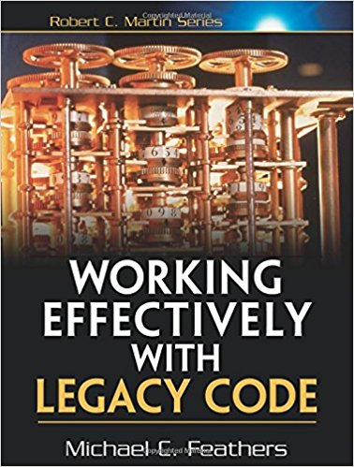
What is Legacy Code?
Michael Feathers defines it as: code without tests

Slide 108
Introducing Unit Tests to Legacy Code
Identify change points
Requires good understanding of system design
Find test points
Based on analysis of effects
Break dependencies using safe refactoring techniques
Write tests
Make changes and refactor

Slide 109
Effects Analysis
Identify method that will change
If it has a return value, examine its callers
Determine if it modifies any values
If so, examine methods that use those values
Also examine methods that use those methods
Make sure you examine super/subclasses
Examine parameters to the methods
Examine global variables and static data modified in any of the identified methods

Slide 110
Breaking Dependencies
Two reasons to break dependencies when putting tests into place
To sense - when we can’t access computation results
To separate - when we can’t get code to run in a test harness
Primary technique - fake collaborators
Impersonate a collaborator of the class under test

Slide 111
Seams
Code place allowing you to alter behavior
Without editing that place
Most Java seams based on polymorphism
Known as object seams
public int value() {
if (null == holding)
return 0;
int price = stockLookupService.price(holding.getSymbol());
return price * holding.getShares();
}
The call to price() is a seam
Can replace the reference stockLookupService

Slide 112
Refactoring Safely
Any manual edits are error prone!
Rely on your IDE refactoring where possible
May need to manual refactor before you are able to write tests
Don’t do more than one thing at a time
Be hyper-aware of the impact of each keystroke
Single-goal editing

Slide 113
Legacy Code Example - Get Code Under Test
asdf

Slide 114
Some Dependency Breaking Techniques
Break Out Method Object
Move a large method to new class
Local variables in original method become fields
Extract Interface
Create an Interface for some subset of methods
Create fake based upon this interface
Introduce Instance Delegator
Solves problem of “static cling”
Opposite of Expose Static Method

Slide 115
Legacy Code Example - Refactor
asdf

Slide 116
WRAP-UP!

Slide 117
Going Forward
Team determines policy going forward
“All new code written using tests”
“Code without tests must be inspected”
Concentrate on legacy code that is causing problems or is the most difficult to modify
Consider pairing
Helps ingrain techniques
Ensures adherence

Slide 118
Final Thoughts
TDD is here to stay
A satisfying and enriching practice that can dramatically increase the quality of your application
Diligent adherence to practice is required to succeed
But the benefits are worth it

Slide 119
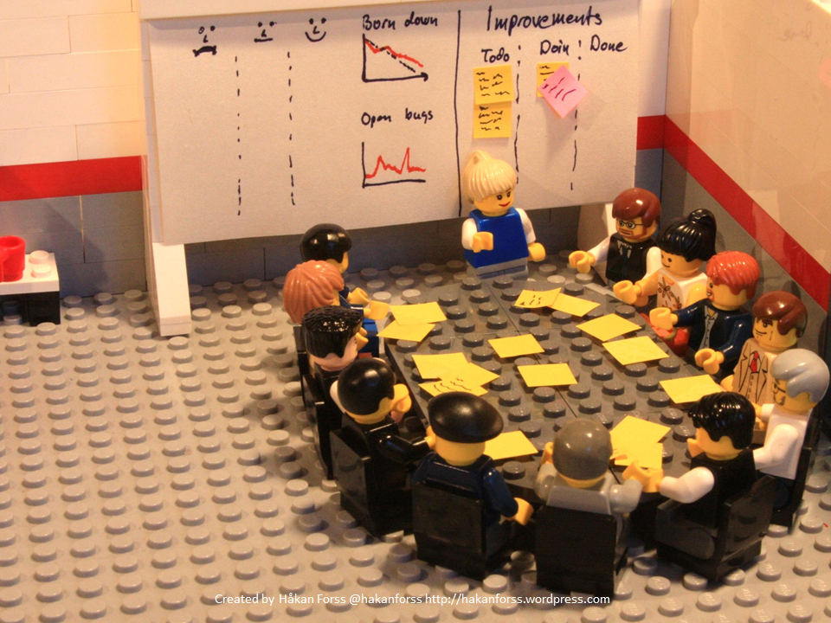
RETROSPECTIVE

Slide 120


